Slide 1

PYTHON TECHIES

Slide 2
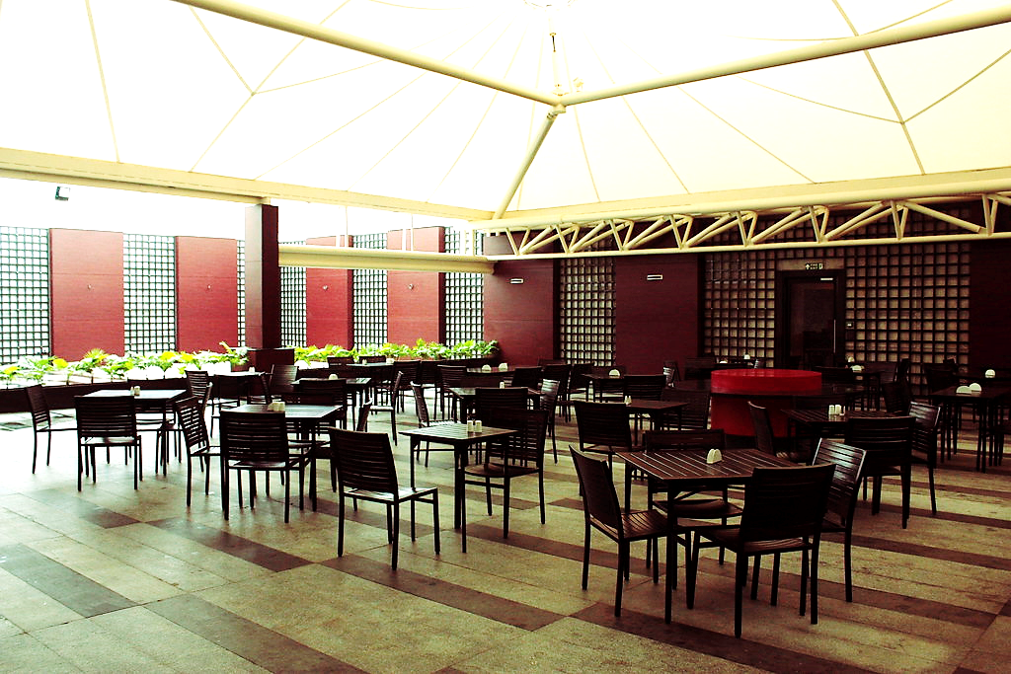
Canteen Management
online

Slide 3

tEAm
K.U.NIKITHA
S.PARINITHA
CH.LOKESH
P.MANI PREETHAM

Slide 4

AGENDA
The main AGENDA of the project is to develop The Billing and Prebooking system in MREC Canteen by making it online

Slide 5

ADVANTAGES
TIME CONSUMPTION REDUCES
MAINTAING SOCIAL DISTANCING
CROWDING IS AVOIDED
CONVINIENCE OF MOBILE ODERING
MORE TIME TO BROWSE MENU
LARGE ORDERS CAN BE PLACED EASILY

Slide 6
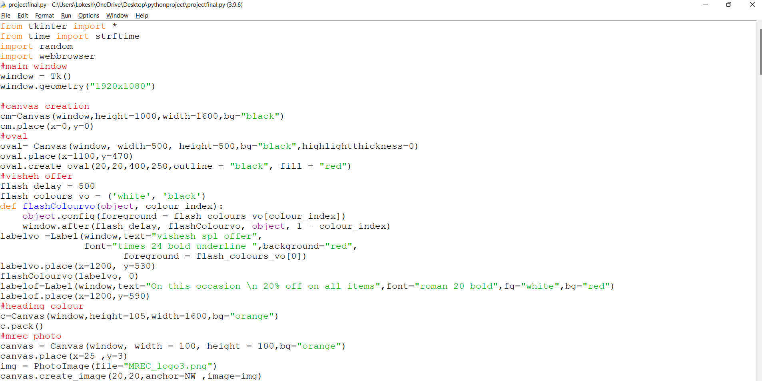
CODE

Slide 7
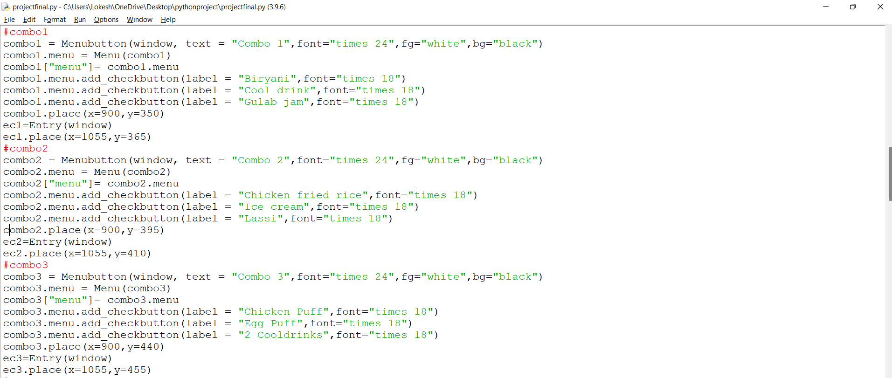

Slide 8
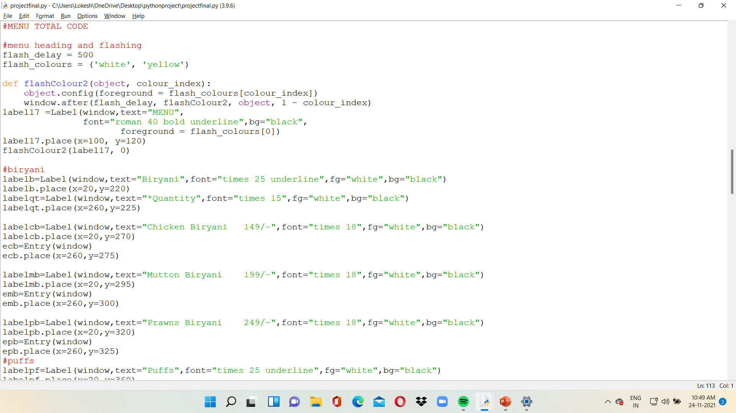

Slide 9
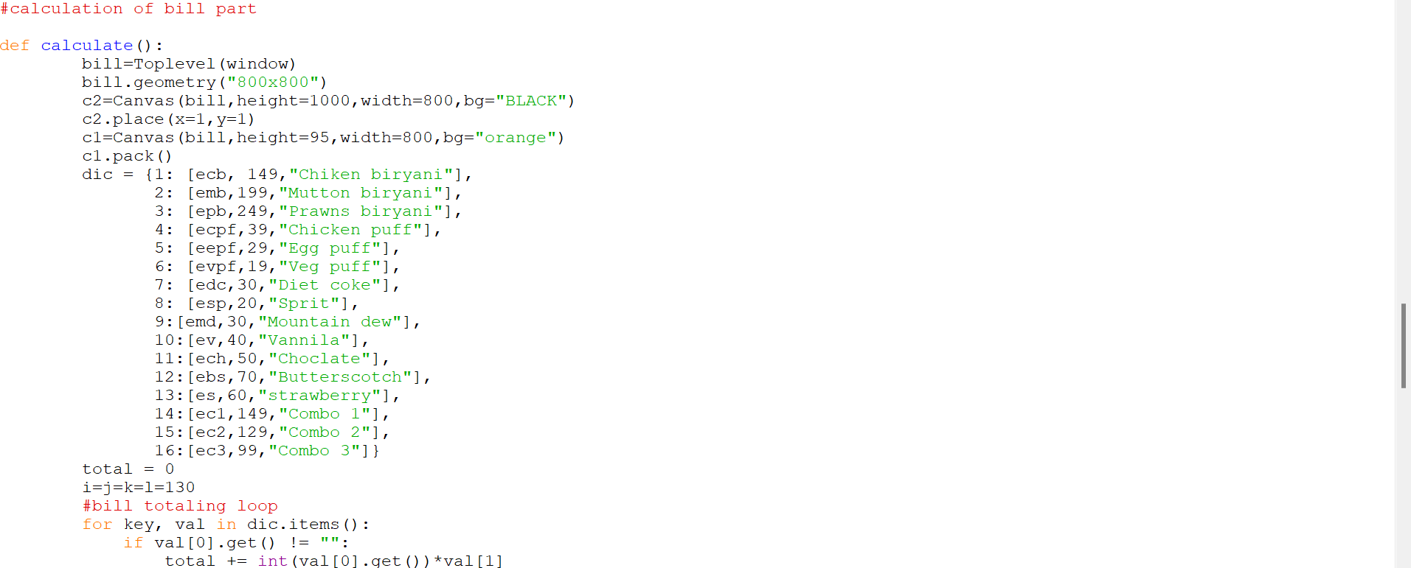

Slide 10
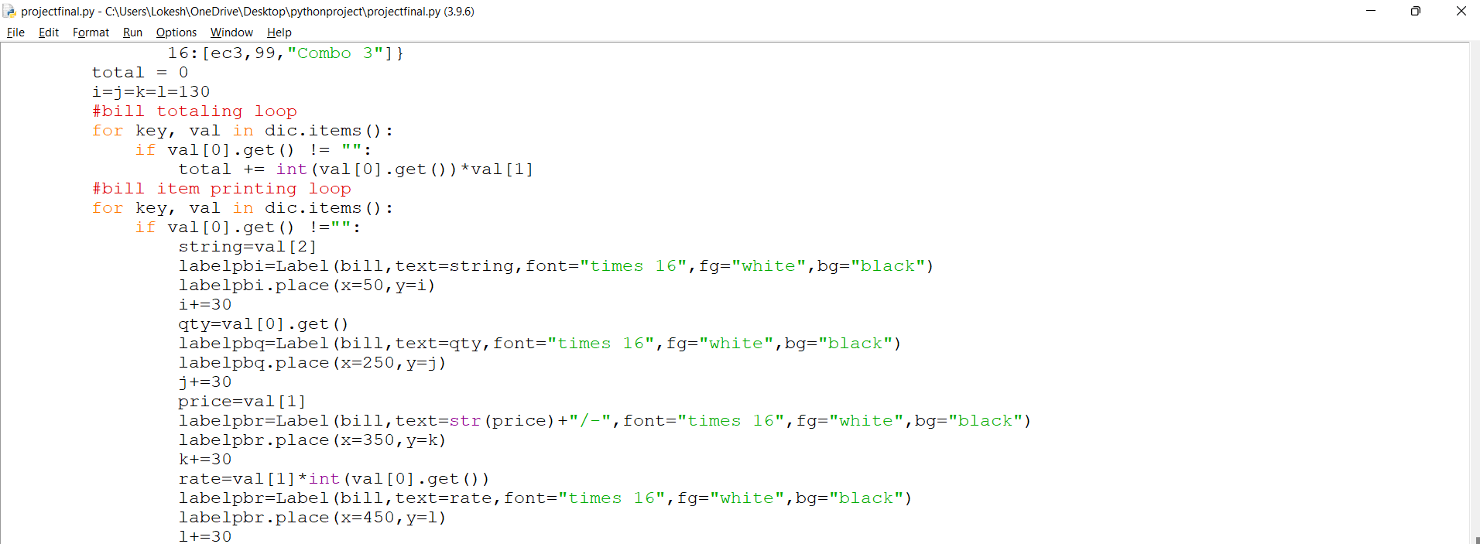

Slide 11
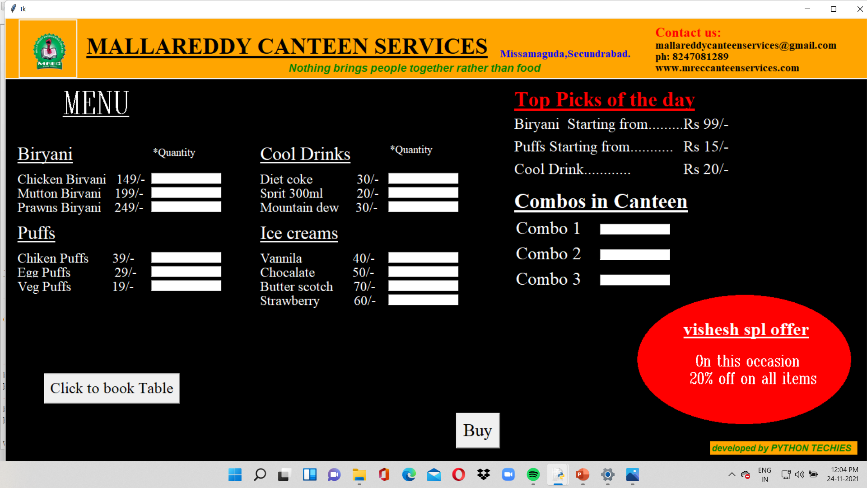
RESULT

Slide 12
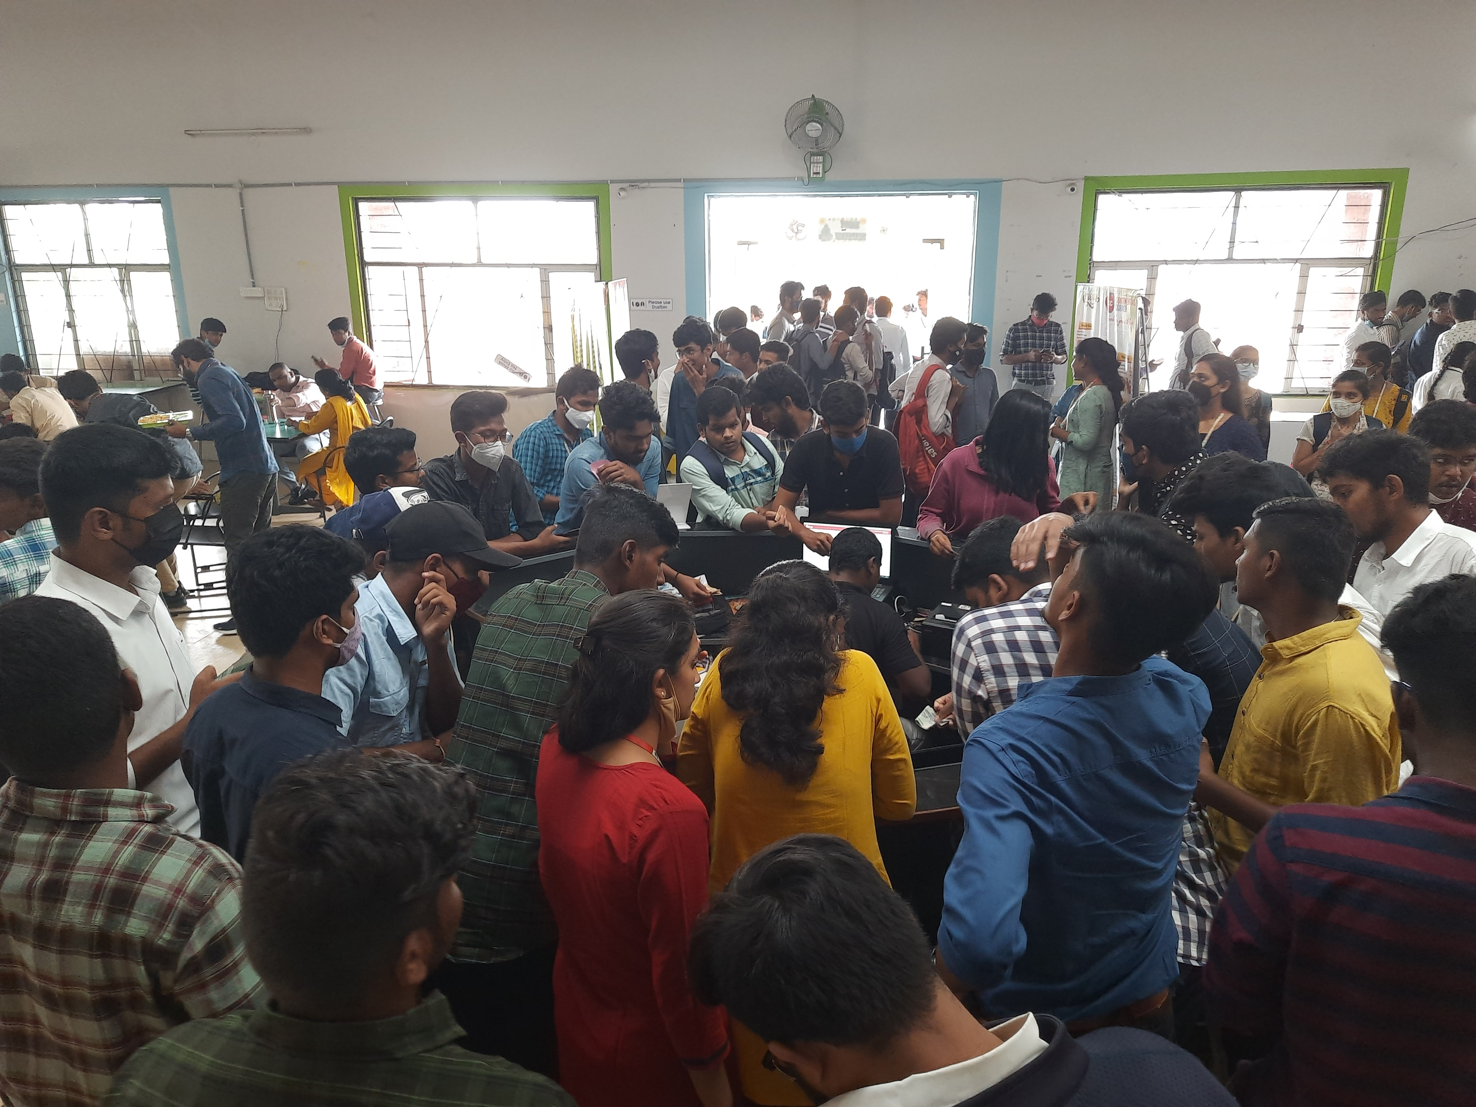
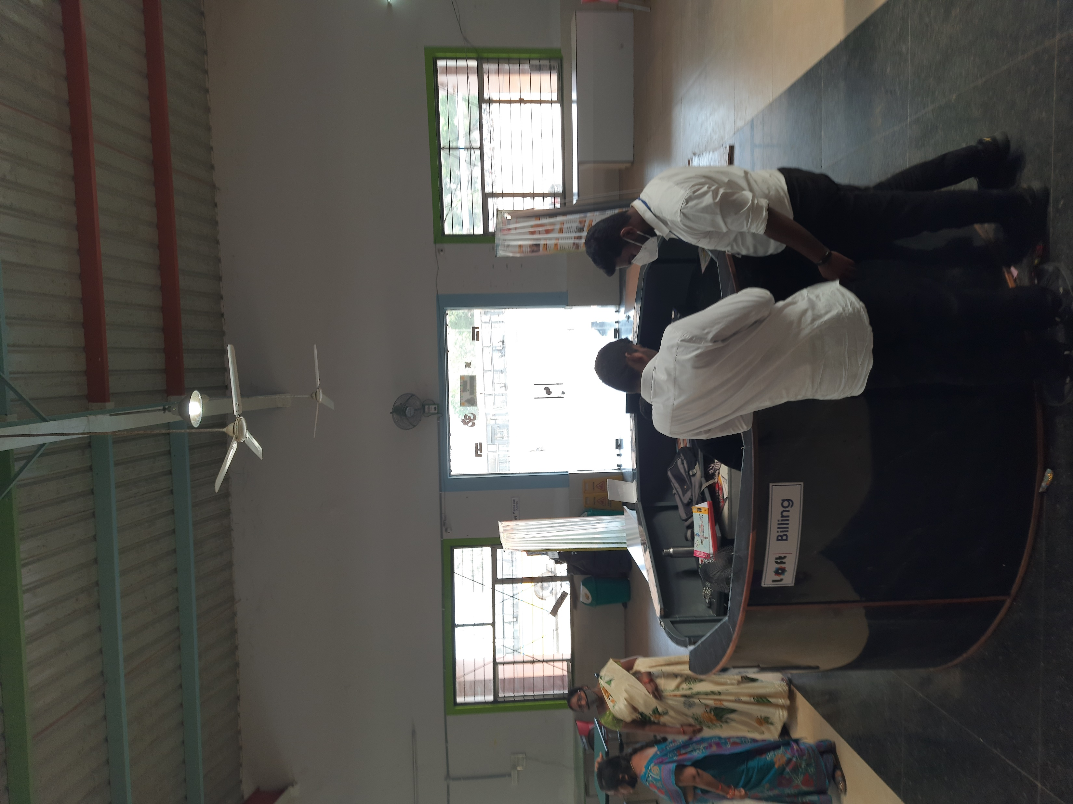
ASSUMPTIONS
BEFORE SENARIO
AFTER SENARIO

Slide 13
Time to eat is less
Crowd in canteen is more
Hunger in students is dying due to lack of time
This time can be managed
By making the canteen management online

Slide 14


